Slide 1
Case Study: Esperanza Rising
Module 1 Unit 2 Lesson 7
Chapter 7: Las Cebollas/Onions
Notes:
Chapter 7- 29:40 -

Slide 2
Learning Targets
I can answer text-dependent comprehension questions about Esperanza Rising using evidence to explain my ideas.
I can describe how the challenges a character faces and how that character responds to those challenges.

Slide 3
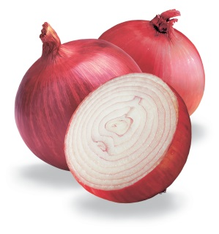
Chapter 7 – Las Cebollas/Onions
What is this chapter mostly about? What happened in this chapter?
Why did Pam Munoz Ryan choose “Onions” as the title to this chapter?
There are onion peels all over the camp, and Esperanza’s job is to sweep them. Esperanza is struggling with this task, and this shows the difference between her life as a rich girl in Mexico and her life as a new campesino in California.

Slide 4
Close Reading of Pages 116-119
Reread pages 116-119
What is Esperanza’s job in the camp?
She had to sweep the onion peels.
What does visualize the memory mean?
She had to try to remember what it looked like.
What does tittering mean? How can we figure out based on context?
Tittering is a short, quiet laugh. We can tell because it says “A group of women were laughing at her.”

Slide 5
Close Reading of Pages 116-117
How does Esperanza feel after Marta call her Cinderella? What does she do?
She was humiliated. She dropper her broom and ran back to the cabin.
What specific words in the text help you know what Esperanza is feeling?
Humiliation, ridicule

Slide 6
Close Reading of Pages 116-117
Think about the challenge Esperanza is facing at this point in the novel. Complete the T-chart below, citing evidence from the text.
Challenge | Responses
Esperanza is tasked with sweeping the platform and she has never held a broom before. | She tried to visualize the memory of Hortensia sweeping but could not get the broom to do what she wanted it to do (116). Miguel found her, explained to her that it was not her fault and proceeded to show her how to hold and use a broom (118-119).

Slide 7
Close Reading of Pages 113-115
Reread pages 113 – 115 and think about the challenge Esperanza is facing at this point in the novel. Complete the T- Chart below, citing evidence from the text.
Challenge | Responses
Esperanza | 1. 2.

Slide 8
Text-Dependent Questions for Chapter 7
You will answer 1 of the three questions with your partner.
Be sure to cite evidence from the text to support your answer.
Answer in complete sentences and answer all parts of the question.

