Slide 1
The United States Constitution
An Introduction and Overview to the US Constitution
5th Grade-History

Slide 2
What is the US Constitution?
The supreme law of the United States
It is the foundation and source of the legal authority underlying the existence of the United States of America and the Federal Government of the United States.
It provides the framework for the organization of the United States Government.

Slide 3
What are the basic principals of the Constitution?
Popular Sovereignty
Government power resides in the people
Limited government
Government is not all powerful, can only do what the people let it
Separation of Powers
Helps prevent one branch from becoming too powerful
Checks and Balances
Federalism
Division of power among national and state governments

Slide 4
What are the Checks and Balances?

Slide 5
Who wrote the US Constitution?
James Madison is considered, “the father of the Constitution”
His important contributions:
The Virginia Plan (Bicameral legislature which proposed that states have representation based on population)
Separation of Powers
Bill of Rights

Slide 6
Why was the US Constitution written?
After the Revolutionary War, the Articles of Confederation set up the structure of the US Government.
The federal government was extremely weak and this created many problems such as:
No separation of powers-only unicameral legislature
Weak central government-states had most power.
Congress did not have the power to tax-this means they could not get their finances in order.

Slide 7
Why was it written?
More problems with the Articles of Confederation:
4. In order to change the Articles, all thirteen states had to approve of the changes. This made it essentially impossible to make any changes.
5. For any major laws to pass they had to be approved by 9 of the 13 states, which was difficult.
6. Congress did not have the power to regulate commerce which caused competition between states. It also caused diplomatic issues when states refused to pay for goods they received from other nations.

Slide 8
When was it written?
May 25th to September 17th, 1787
Philadelphia
Intention was to revise Articles of Confederation
Ended up replacing the Articles and creating a new government
Called the “Constitutional Convention”

Slide 9
What were the important outcomes of the Constitutional Convention?
Virginia Plan:
Separation of powers
Bicameral legislature based on population
Federal government had increased powers
New Jersey Plan:
Unicameral legislature where every state received equal representation
Great Compromise:
Hybrid of VA and NJ Plans:
Bicameral legislature:
House of reps based on population
Senate based upon equal representation
Three-Fifth’s Clause
Slaves count as 3/5’s of a person for representation purposes

Slide 10
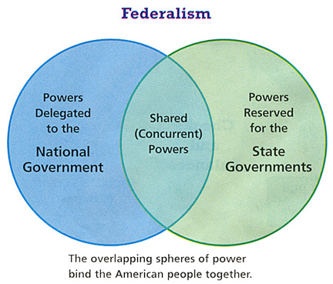
Ratification Debate
Needed 9 of 13 states to ratify or officially approve of the Constitution before it went into effect
A huge debate emerged between two sides:
Federalists
Anti-federalists

Slide 11
Federalists V. Anti-Federalists
Federalists
Anti-Federalists
Supported the constitution and a strong central government
Alexander Hamilton, James Madison, John Jay
Federalist papers- series of articles written in defense of the constitution
Supported a weaker central government-felt too much power was taken away from the states
Opposed the Constitution
Wanted a Bill of Rights included
Samuel Adams, Patrick Henry

Slide 12
Ratification
Officially adopted after ratified by New Hampshire
Once the new government convened, they added a bill of rights to the Constitution.

Slide 13
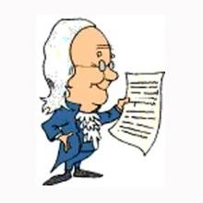
Structure of the Constitution
Preamble:
Statement of Purpose
Articles:
I:Legislative Branch
II: Executive Branch
III: Judicial Branch
IV: Relations among the states
V: Amendment process
VI: Federal Power
VII: Ratification
Amendments:
27 total
1st ten are Bill of Rights

Slide 14
Article I: Legislative Branch
Bicameral:
Senate ( 6 years)
2 senators for each state
House of Representatives (2 years)
Based on population
Important Powers:
Make laws
Set taxes
Declare war
Override vetoes
Borrow money
Regulate international and national trade
Print money

Slide 15
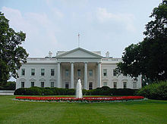
Article II: Executive Branch
President and Vice President (4 year term)
Qualifications:
At least 35 years old
14 year resident of the US
Natural born citizen
Elected by the electoral college
Important Powers:
Commander-in-Chief
Grant Pardons
Make Treaties
Appoint federal officers
Ensure laws are executed

Slide 16
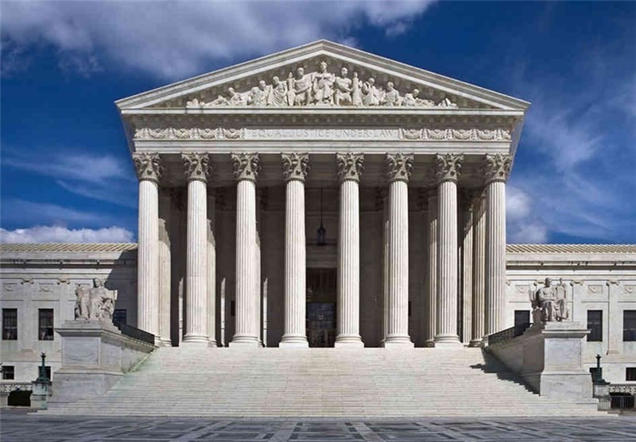
Article III: Judicial Branch
Supreme Court judges serve for life unless impeached
Judicial power rests with US Supreme Court and other courts created by Congress
Important Powers:
Decides cases of Constitutional law and federal law
Cases involving ambassadors go straight to Supreme Court

Slide 17
Other Important Articles:
Article V: Amendments:
Amendments are proposed when 2/3 of the house and senate deem it necessary
Amendments are proposed when 2/3 of the states deem it necessary
Amendments must be ratified by ¾ of state legislatures or by conventions in ¾ of the states.
Article VI: Federal Power
Supremacy Clause: Federal law is supreme to state law
No religious tests for public office

Slide 18
Important Amendments: Bill of Rights
Freedom of religion, of speech, of the press, to assemble, and to petition
Right to bear arms
No quartering of soldiers
No unreasonable search and seizure
Indictments; due process; self-incrimination; double jeopardy, and rules for eminent domain
6. Right to fair and speedy public trial, notice of accusations, confronting one’s accuser, subpoenas, right to counsel
7. Right to trial by jury in civil cases
8. No excessive bail and fines or cruel and unusual punishment
9. There are no other rights not written in the constitution
10. All rights not given to Federal Government belong to states and people.

